Slide 1
XPETS Experimental Code
By Grant Buster
July 17, 2015

Slide 2
XPETS Calibration Geometry Solver (same as non-experimental Module 2 code)

Slide 3
Importance of Geometry
An accurate 3D reconstruction is impossible without a good geometry solution
What does this mean?
4 key geometric parameters need to be defined:
Y_of (y axis distance from origin to focal/source point)
O_x (x axis distance from right hand side of detector to origin)
O_y (y axis distance from detector plane to origin)
O_z (z axis distance from top of detector to origin)
Turntable Rotation Axis
Set as Origin
X-Ray Point Source
Detector Plane

Slide 4
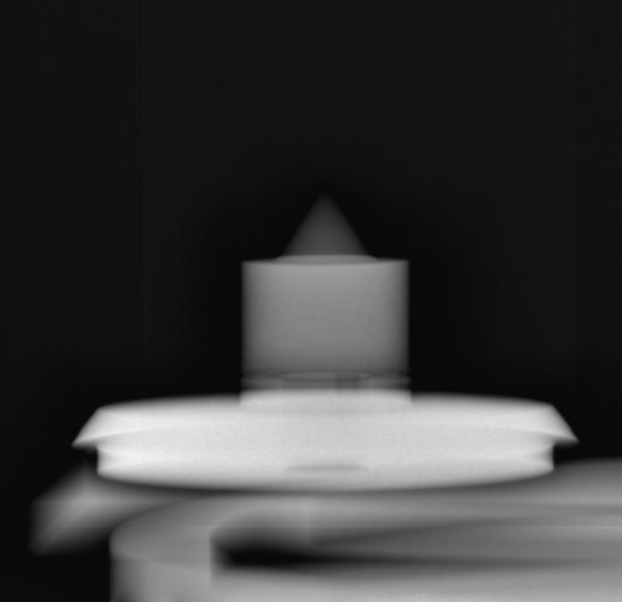
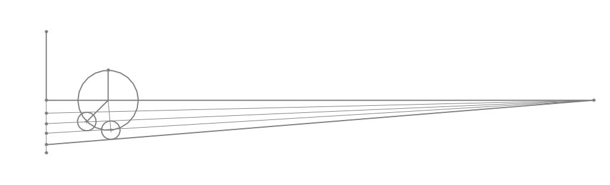
O_y and Y_of
O_y and Y_of have been defined using a machined reference geometry and Solidworks geometry solver
O_y = 0.2283 (m)
Y_of = 1.8453 (m)
These values should be considered constant unless:
The turntable is moved
The columnator or detector are moved in the y-direction (but vertical shifts should not affect O_y and Y_of)
Machined Reference Piece
SolidWorks Geo Solver
Detector Plane
B)
Radius of Rotation
A)
C)
A)
B)
C)
Reference Piece Diameter
Reference Piece Diameter

Slide 5
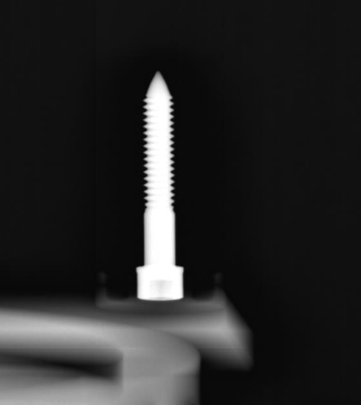
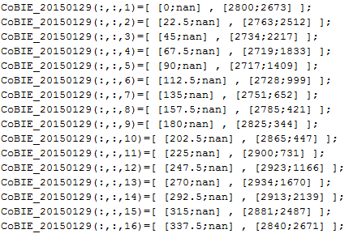
Defining O_x
We define O_x using an x-ray image set of a single point (usually a thumb screw) rotated through 360 degrees. NOTE: the screw should be placed as far off-center as possible (away from the center of the detector in z and x directions).
The angle and the i,j tip location (in pixels) (i=column#, j=row#) for each image need to be entered in the format:
Ox_DATA(:,:,1)=[ [angle;nan] , [ j ; i ] ];
Into the code: XPREX_20141029_Full_Geo_Solver.m
Example:
XPREX_20141029_Full_Geo_Solver.m

Slide 6
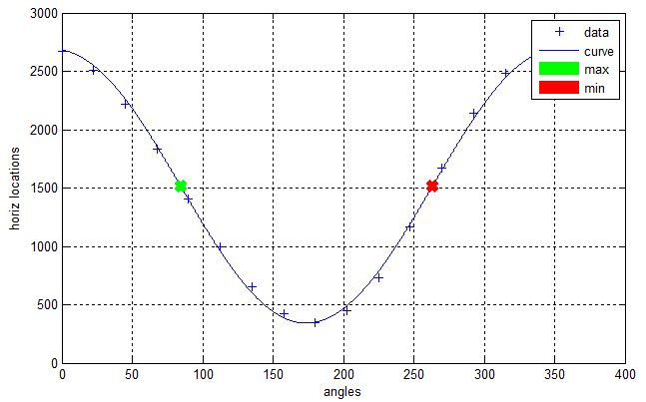
Defining O_x
XPREX_20141029_Full_Geo_Solver.m then utilizes the fact that the horizontal location of the screw tip will move in a sinusoidal path:
XPREX_20141029_Full_Geo_Solver.m will automatically calculate any angle offset and O_x
Angle offset is caused by the screw not being placed perfectly at 0-degees when the turntable is at 0-degrees. This is accounted for and it is okay to place the screw at a random angle.

Slide 7
Defining O_z
This is the (algebraically) difficult part
Start from a top-down view, in order to calculate the radius of rotation of the thumb screw tip
Radius of rotation is calculated by the following equation:
Where i is the horizontal pixel location (column index) of the thumbscrew tip in one image. This is usually taken when the screw is far right or far left. Theta in the above equation is theta of the turntable plus the theta offset
Turntable Rotation Axis
Set as Origin
Thumb-Screw
Radius of Rotation
X-Ray Point Source
Detector Plane

Slide 8
Defining O_z
We move to a side-view, in order to calculate O_z
Two images are picked, usually the two where the thumbscrew tip is highest and lowest in the image
R1 and R2 are calculated using R_rot*sin(theta), in the domain:
O_z is calculated as follows:
K2
K1
R2
R1
O_z
X-Ray Point Source
Detector Plane

Slide 9
Geometry Solved!
The geo.mat file should now be good to go!
Two other important parameters:
The detector has 6993 pixels per meter (PPM)
A pin/pebble diameter is 0.01257 (m)
The geo.mat file should be placed in the active directory, and loaded before module2 starts to run

Slide 10
XPETS Experimental 3D Bed Reconstruction

Slide 11
Experimental Search Algorithm
The experimental code operates on the principle that it should be easier to search for an instrumented pebble in a 3D space
In broad strokes this is the idea:
Assume you can find a point in 3D where you think a tungsten pin was in the actual test section (we’ll go through how you find this point in a minute)
You should be able to scan around that point and find two other points that appear (in the x-ray and contrast images) to be on the same pin
Those two points should give you a pin orientation
You can then “walk along” that orientation, verifying that you are still on a pin in your images
Once you “step off” of the pin, you can verify that you have found a pin of an appropriate length
Let’s see how this is done…

Slide 12
Module 2 Code Architecture
Experimental_Find.m
Get_1pnt_Vector.m
Look_at_Image2.m
Geo
Contrast Data
Find_Pin_Orientation.m
Luminosity Data
Walk_Along_Pin2.m
Thresholds
Validator.m
Render_Pebbles.m

Slide 13
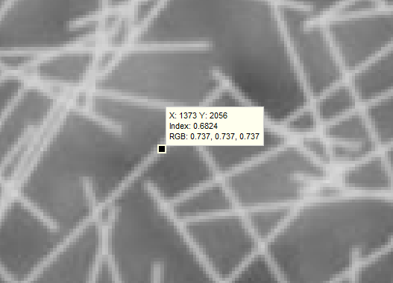

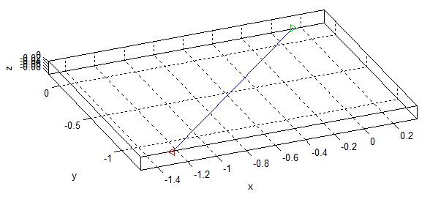
The Starting Point
Start with a point that you know is on a single pin in an x-ray image. This is currently a user input, but in theory it shouldn’t be hard to automate
In Experimental_Find_05.m:
plot
point3D
(on detector plane)
point3D+vector3D
Origin (0,0,0)
X-ray source

Slide 14
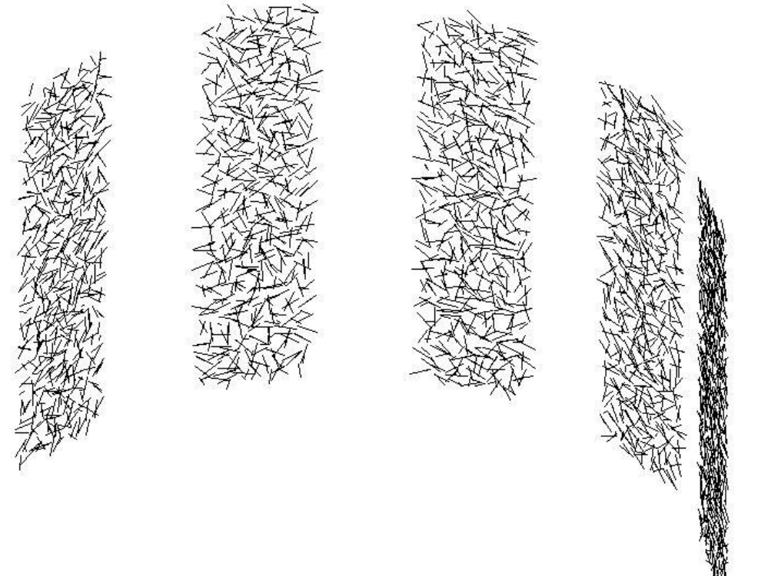
The Starting Point
Experimental_Find_5.m will then iterate from point3D along vector3D to a user-input endpoint
The code uses Look_at_Image2.m to check each point along vector3D against luminosity and contrast sets
Contrast and luminosity data at each point along vector3D are then stored in “point_assessments”
Luminosity and contrast
data sets at each angle
point3D
(on detector plane)
point3D+vector3D
Tested points
Tested point
X-ray source

Slide 15
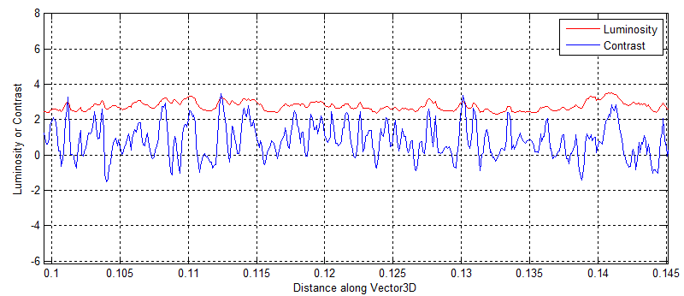
The Starting Point
Contrast and luminosity data at each point along vector3D are then stored in “point_assessments” and can be seen plotted here:
The code has to pick a select few of the points along vector3D to test. The selection method certainly deserves improvements
Keep computational cost in mind
Once you pick points to try, you have your starting points

Slide 16
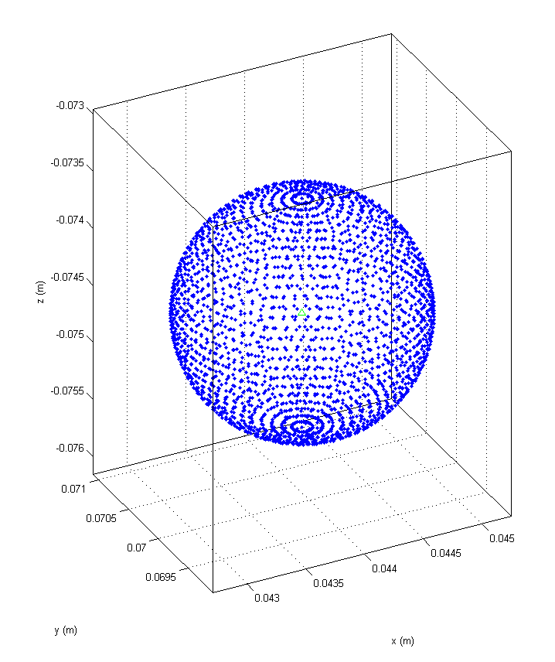
Finding the Orientation of a Pin
Now that you have a starting point in 3D that you think may belong to an actual tungsten pin in the test section, you can try and find the orientation of that pin
Find_Pin_Orientation.m checks a ton of points in a sphere around your starting point
The function currently returns a single direction based on the best contrast or luminosity data
Start point
Tested orientations

Slide 17
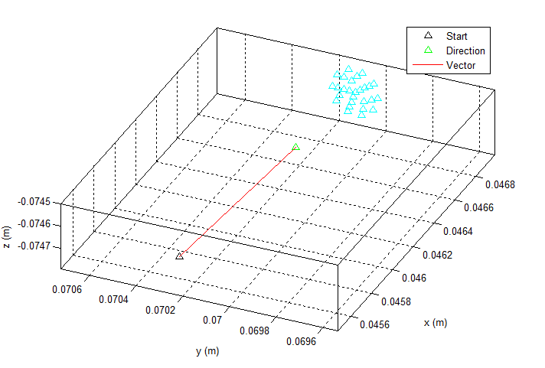
Tracking a Pin
Once an orientation has been determined, the code “walks along” the pin in both the positively tested direction and the opposite direction (forward and backward)
The code tests points in the asserted direction, allowing for a certain angular error. This creates a cone-shaped projection
Once the code “walks off” of a pin, i.e. none of the tested points fulfill the threshold criteria, the code saves the most opposite points, tests the length and hopefully determines that a pin was indeed found

Slide 18
Conclusions
This method has been shown to work very well for isolated pins (perfectly ideal cases) and also with mixed results for pins in beds with depth up to 12 pebble diameters
By testing multiple points along a pin in the 2D image, the 3D pin should certainly be findable
The full algorithm is very clearly half-baked, but the methodology deserves more exploration
The full algorithm would iterate through 2D locations that have very high contrast ridges (Mike’s module 1 code does a great job of determining these locations)
Found pins could eliminate many possibilities

Slide 19
Conclusions
Here are some proposed improvements:
The algorithm that selects from “point_assessments” needs to combine normalized luminosity and contrast data and also account for contrast “ridges” (strong positive surrounded by negative contrast)
This is possibly most important. Testing only one point is surprisingly fast. If less than 5 points could be identified as possibilities, this code would be speedy.
The starting point in the 2D image should be selected so it is not the endpoint of a pin
The orientation should then be found such that the opposite orientation is also verified at the same time in the same sphere of tested points
Several spheres of tested points (w/ different radii) could be tested at the same time to try to find a consistent orientation

Slide 20
UPDATE: 7/30/15
Experimental_find_06 was recently written and is working towards a good idea that Grant and Mike had. Here’s the general idea:
Mike’s module1 code is good at finding single endpoints in 2D with the corresponding pin direction
Grant rewrote experimental_find_06 so that it finds starting points based on where endpoints in multiple images intersect in 3D. This is done with a vector intersect function that calculates how close two vectors get in 3D space.
Experimental_find_06 still attempts to find the pin orientation using a sphere of checked points
Eventually, using Mike’s code that gives the 2D orientations of pin, experimental_find should be able to use the 2D orientations to yield a 3D direction that can be used as a starting direction for the “walk_along_pin.m” function.

